Slide 1
Hadoop MapReduce
How to Survive Out-of-Memory Errors
The International Summer Undergraduate Research Fellowship
Faculty Mentor: Professor Harry Xu Student Mentor: Khanh Nguyen Member: Yoonseung Choi
Soyeong Park
Notes:
Anteater is so cute

Slide 2
Outline
Introduction
What is MapReduce?
How does MapReduce work?
Limitations of MapReduce
Objectives
Operation test

Slide 3
“There was 5 exabytes of information created between the dawn of civilization through 2003,
But that much information is now created
every 2 days, and the pace is increasing...”
- Eric Schmidt, Google CEO
Notes:
Before the speech
spoke at the Techonomy conference(10’) in Lake Tahoe
http://readwrite.com/2010/08/04/google_ceo_schmidt_people_arent_ready_for_the_tech

Slide 4
Data scientists want
to analyze these
large data sets
How can we handle that?
Distribute processing
But single machines
have
limitations
in processing
these data sets
Do we need to
understand
the details of
parallelization,
fault tolerance,
data distribution
and load balancing?
parallelization
fault tolerance
data distribution
load balancing
Furthermore, data sets
are now growing very rapidly
The answer is ‘no’

Slide 5

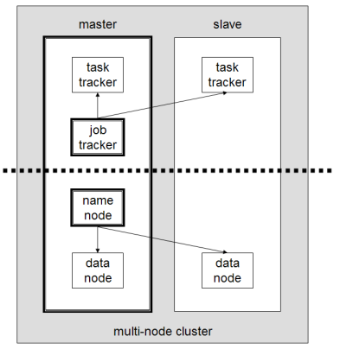
MapReduce is a programming model for processing and generating large data sets
Many real world tasks are expressible in this model
MapReduce Layer
HDFS Layer
The model is easy to use, even for programmers without experience with parallel and distributed systems
* https://en.wikipedia.org/wiki/Apache_Hadoop
[1] Jeffrey Dean and Sanjay Ghemawat. (2004). “MapReduce: Simplified Data Processing on Large Clusters”.

Slide 6
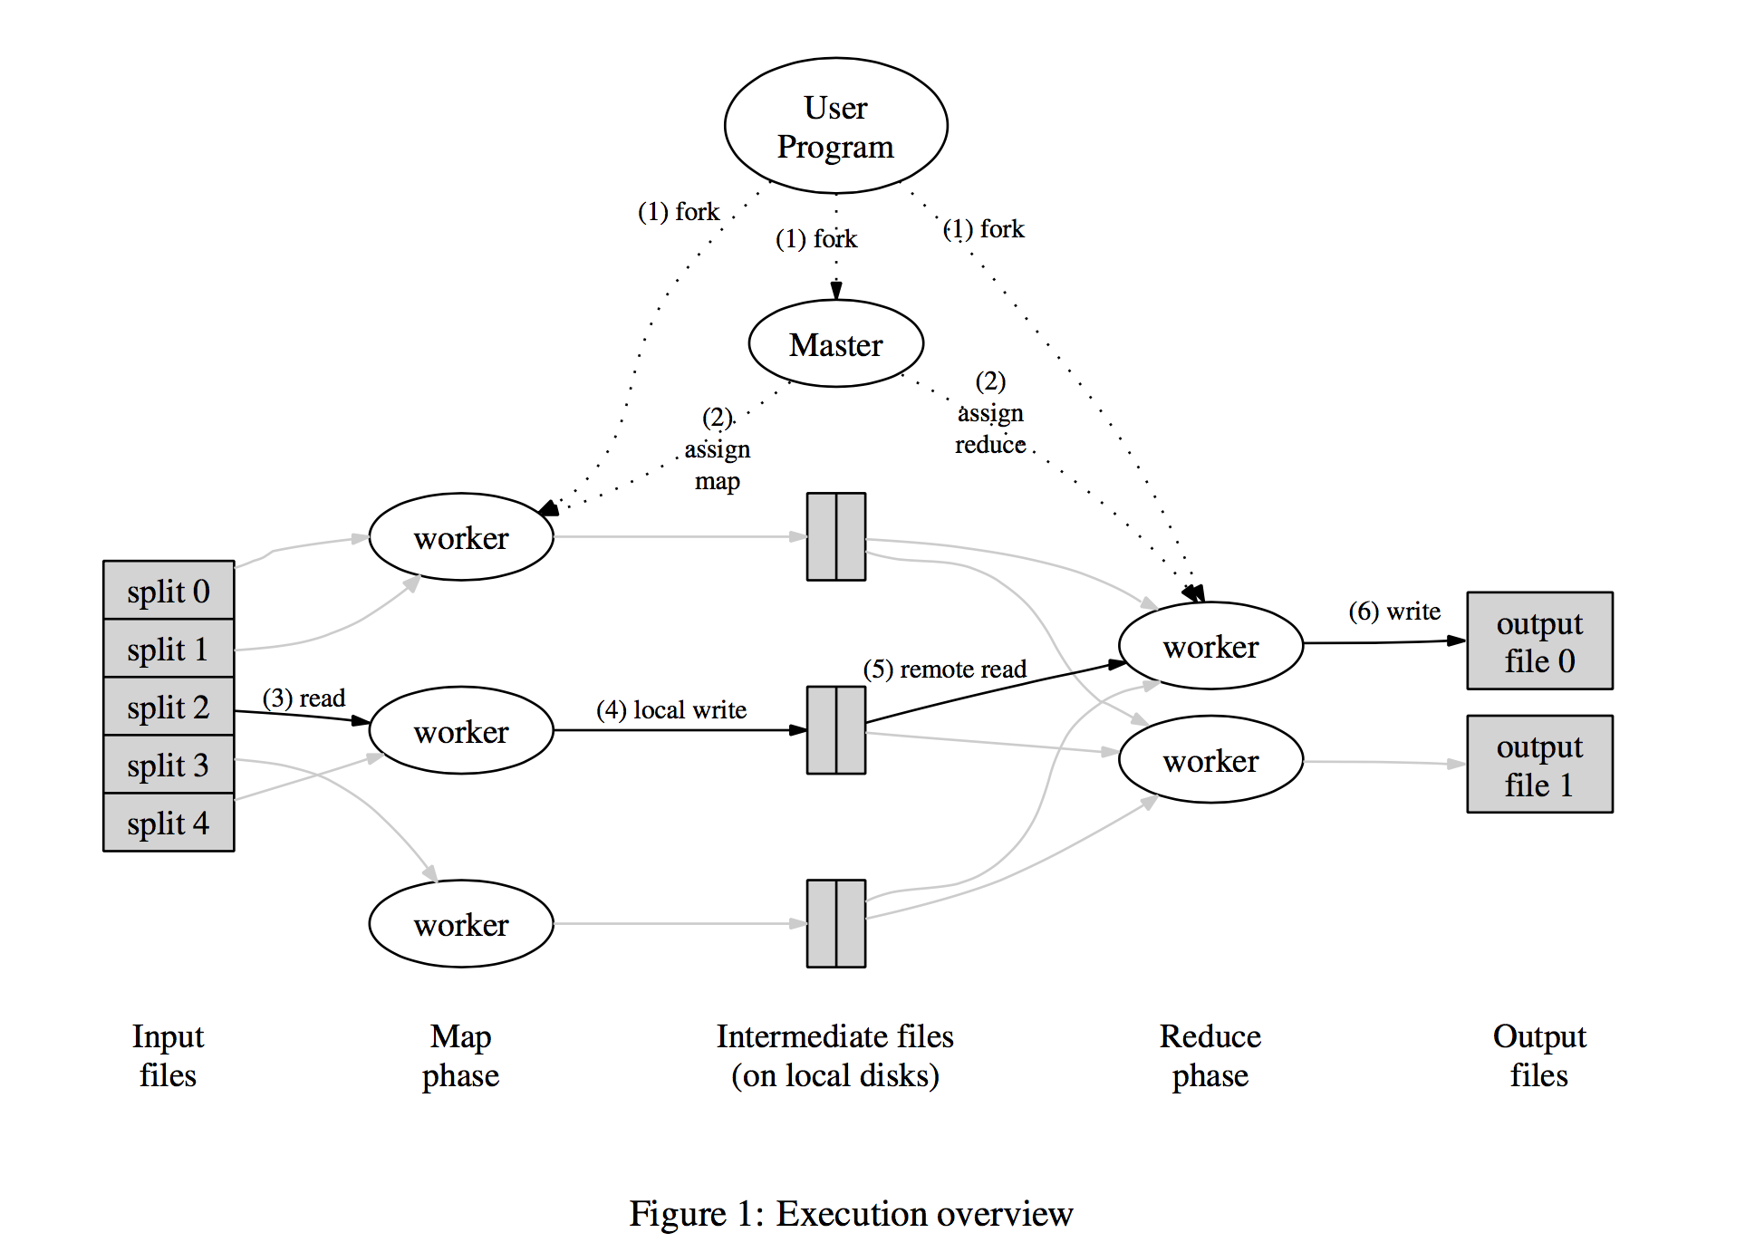
What is MapReduce?
Mapper takes an input
and produces a set of
intermediate key/value pairs
Reducer merges together these
Intermediate values associated
with the same intermediate key
[1] Jeffrey Dean and Sanjay Ghemawat. (2004). “MapReduce: Simplified Data Processing on Large Clusters”. p.12
Notes:
[1, p.12] – map > emit
* ADD AN ANIMATION

Slide 7
How does MapReduce work?
The cat sees the dog, and the dog sees the cat.
The cat sees the dog
cat, 1
Reduce
Phase
dog, 1
sees, 1
and, 1
Map Phase
the, 2
cat, 2
dog, 2
and, 1
sees, 2
And the dog sees the cat
cat, 1
the, 4
dog, 1
sees, 1
- wordcount program
- A sentence is split
into two map tasks
the, 2

Slide 8
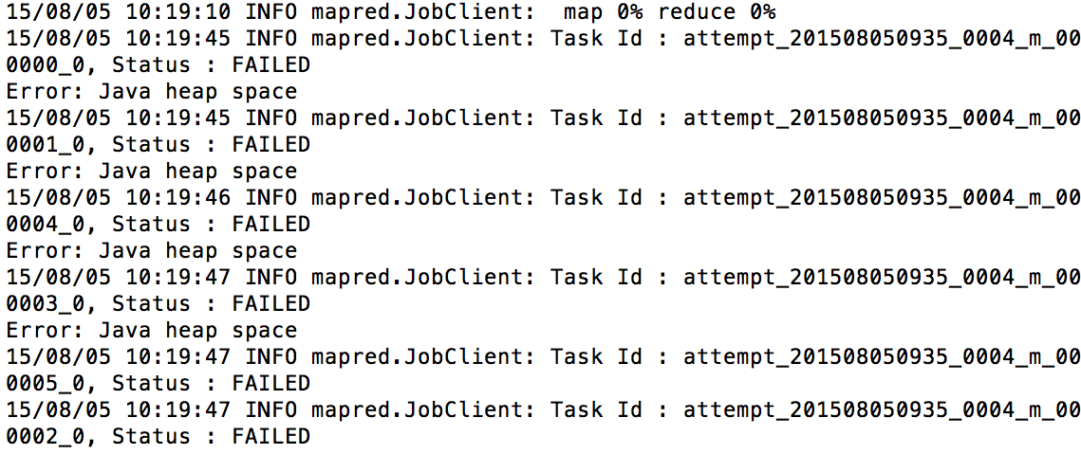
Limitations of MapReduce
Out-of-Memory Errors
High Memory Pressure
Inappropriate Configuration
There are many reasons for poor performance
And even experts sometimes can’t figure them out
Notes:
- 논문에 써있는 configuration parameter 수 체크
From now on, next contents are little a bit technical.
So don’t sleep.
Because many programming models which uses MR are generally implemented by managed languages like JAVA or C++
It uses garbage collector and sometimes it make problem

Slide 9
Objectives
Research Out-of-Memory Error cases
OOM cases documentation
Implement and simulate StackOverflow OOM cases
Develop solutions for such OOM cases
Notes:
I want to tell you what we are doing now

Slide 10
Three Categories
Inappropriate Configuration Configuration which causes poor performance
Large Intermediate Results Temporary data structure grows too large
[3] Lijie Xu, “An Empirical study on real-world OOM cases in MapReduce jobs, Chinese Academy of Sciences.
Notes:
We research some papers, and there’re some patterns which make an OOM. And we can categorize this patterns into 3 categories.

Slide 11
Inappropriate Configuration - Operation test environments
Standalone & Pseudo-distributed mode - ‘14 MacBook Pro, 2.8 GHz Intel Core i5 8GB 1600 MHz DDR3, 500GB HDD - ‘12 MacBook Air 1.4, GHz Intel Core i5 4GB 1600 MHz DDR3, 256GB HDD
Fully-distributed mode - Raspberry Pi 2 Model B (3 nodes) A quad-core ARM Cortex-A7 CPU (1Ghz Overclock) 1GB 500MHz SDRAM, 64GB HDD, 100Mbps Ethernet

Slide 12
Single node Operation test
Input: StackOverflow’s users profiles (1GB)
Test program: Standard deviation of users’ age - Standalone: 1M1R
- Pseudo distributed: 2M2R, 4M2R
Running time(sec)
Split size (MB) | Running time(sec)
 | 1M1R | 2M2R | 4M2R
16 | 173.3 | 204.0 | 169.3
32 | 88.3 | 117.3 | 117.3
64 | 47.3 | 86.3 | 78.7
128 | 26.7 | 64.7 | 59.0
256 | 24.3 | 56.3 | 55.0
Split size(MB)
* ‘14 MacBook Pro 2.8, GHz Intel Core i5, 8GB 1600 MHz DDR3, 500GB HDD
Notes:
Show just running time decrease

Slide 13
Single node Operation test
Input: StackOverflow’s Comments (8.5GB)
Test program: Standard deviation of comment’s text length - Standalone: 1M1R
- Pseudo distributed: 2M2R, 4M2R
Running time(sec)
Split size (MB) | Running time(sec)
 | 1M1R | 2M2R | 4M2R
16 | 1577.7 | 1586.3 | 1590.0
32 | 807.7 | 831.0 | 803.7
64 | 425.0 | 634.0 | 540.3
128 | 411.0 | 454.3 | 397.7
256 | 312.3 | 299.0 | 323.0
Split size(MB)
* ‘12 MacBook Air 1.4, GHz Intel Core i5, 4GB 1600 MHz DDR3, 256GB HDD
Notes:
Show just running time decrease

Slide 14
Single node Operation test
Input: StackOverflow’s Comments (8.5GB)
Test program: Standard deviation of comment’s text length - Standalone: 1M1R
- Pseudo distributed: 2M2R, 4M2R
Running time(sec)
io.sort.mb | Running time(sec)
 | 1M1R | 2M2R | 4M2R
20 | 872.0 | 661.0 | 633.7
40 | 827.0 | 638.7 | 641.0
80 | 814.0 | 632.0 | 635.7
160 | 798.0 | 629.7 | 629.3
320 | 803.7 | 629.7 | 629.0
* ‘12 MacBook Air 1.4, GHz Intel Core i5, 4GB 1600 MHz DDR3, 256GB HDD
Notes:
Factor value 가 io.sort.mb의 1/10임을 말로 설명
Show just running time decrease

Slide 15


Fully-distributed Operation test
Input: StackOverflow’s users profiles (1GB)
Test program: average users’ age based on countries
Running
time(s)
Split
size
Split size |  | 32MB | 64MB | 128MB | 256MB
Running time | 6 Mapper | 375s | 396s | 442s | 548s
 | 12 Mapper | 313s | 296s | 350s | 557s
* Raspberry Pi 2 Model B (3 nodes) A quad-core ARM Cortex-A7 CPU (1Ghz Overclock) 1GB 500MHz SDRAM, 64GB HDD, 100Mbps Ethernet
800MHz (6M6R) | 32MB | 64MB | 128MB | 256MB
1st | 8m28s | 8m32s | 10m0s | 12m46s
2nd | 8m35s | 8m44s | 9m58s | 12m14s
3rd | 8m33s | 8m59s | 10m13s | 13m38s
Avg. | 8m32s | 8m45s | 10m4s | 12m53s
[master]
[worker1]
100Mbps
Ethernet
[worker2]
Notes:
Why graph grows?
Because 256 split size has just 4 map tasks
It means 2 of 6 mapper will not work.
So we need more bigger

Slide 16
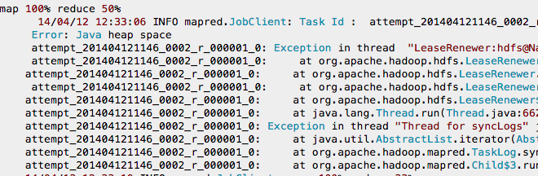
Large Intermediate Results - Summary of problem
Getting java heap space error while running a MapReduce code for large dataset - Need to be optimized

Slide 17
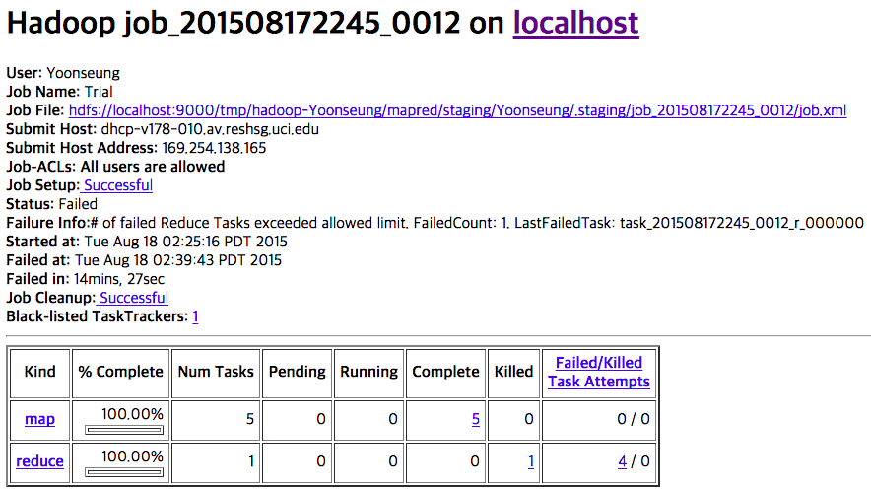
Large Intermediate Results - The result of testing original code

Slide 18
Large Intermediate Results - Summary of solution
Java heap can’t contain the result of map A’s result (the intermediate file)
The result of phase A: 4,799,999,952B
One map tasks: at least 959,999,990B(almost 1GB)
To solve this problem, modify the value as below.
 | Original code | Solution code
Split size(MB) | 256 | 128
# of Job tasks | 2 | 3
JAVA HEAP SIZE | ? | 256

Slide 19
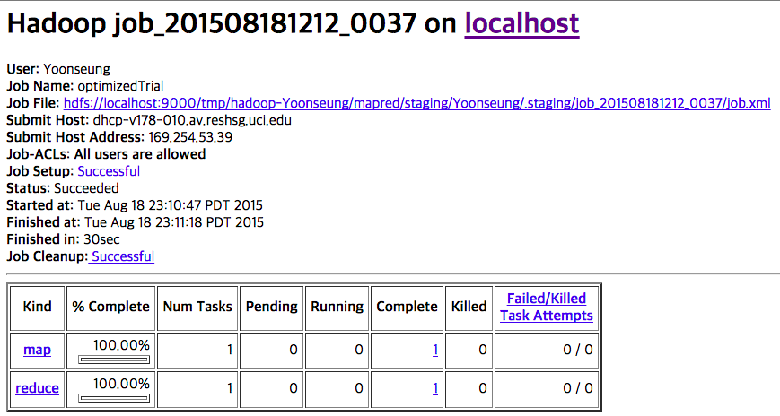
Large Intermediate Results - The result of testing solution code

Slide 20
Thank You
And if you want to know more technical information, please enter our GitHub repository.
https://github.com/I-SURF-Hadoop/MapReduce

Slide 21
appendix
How does MapReduce really work?

Slide 22
How does MapReduce work?
The cat sees the dog, and the dog sees the cat.
The cat sees the dog
the, 1
Combining & Sorting
[ Map Phase ]
cat, 1
cat, 1
MapReduce library first splits the input into M pieces.
A map worker processes these pieces using a user-defined Map function. Intermediate key/value pairs will be produced by this function.
sees, 1
dog, 1
the, 1
sees, 1
dog, 1
the, 2

Slide 23
How does MapReduce work?
The cat sees the dog, and the dog sees the cat.
cat, 1
Shuffling
[ Reduce Phase ]
dog, 1
and, 1
sees, 1
When a reduce worker has read all intermediate data, it sorts them by the intermediate keys.
The reduce worker iterates the sorted intermediate data and for each unique intermediate key encountered, it passes the key and the values to the user’s Reduce function.
cat, 2
the, 2
dog, 2
and, 1
sees, 2
cat, 1
the, 4
dog, 1
sees, 1
the, 2
Two independent reducer

